Slide 1
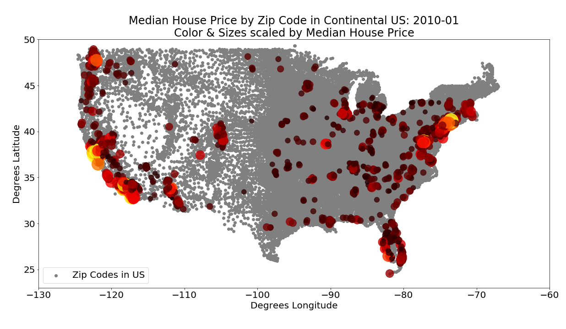
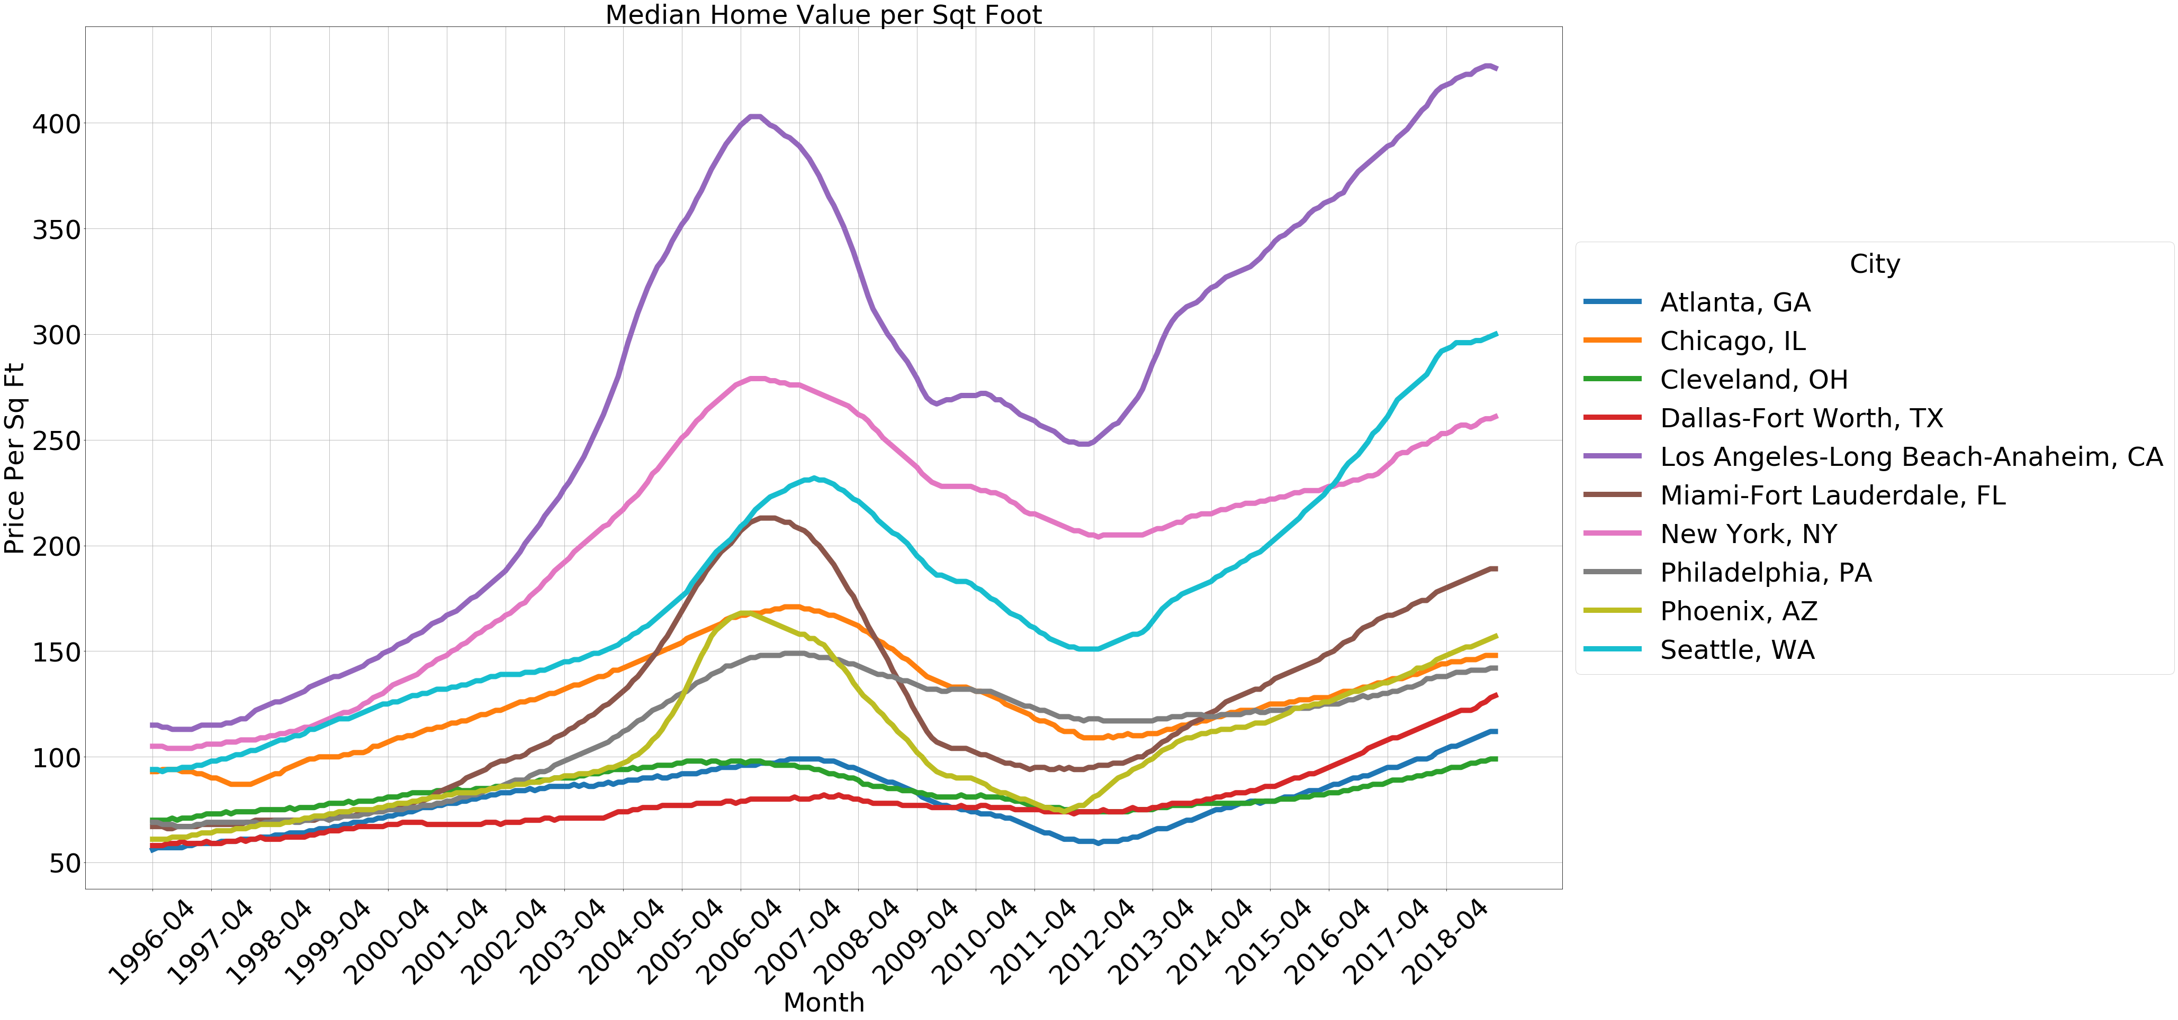
An Analysis of the Factors that Impact Housing Costs in the US
Kim Harrison
Kent Hazen
Tim Tang
Laura De Morneau
9 April 2019

Slide 2
Our approach was to utilize datasets from different sources to determine what factors impact housing prices
Demographics
Severe Weather Events
Rent or Buy?
House Layout
Notes:
How do location demographics impact housing prices? What is the impact of gentrification? (Lead by Kent)
What are the features of the houses & properties that can impact the price of houses? We’ll look specifically at data from LA, Orange, and Ventura counties. (Lead by Kim)
What is the impact of weather and/or environmental factors on housing prices? (Lead by Laura)
What factors impact the decision to rent or buy? (Lead by Tim)

Slide 3
Our approach was to utilize datasets from different sources to determine what factors impact housing prices
House Prices, Amenities
Demographic, City Info
Weather Data

Slide 4
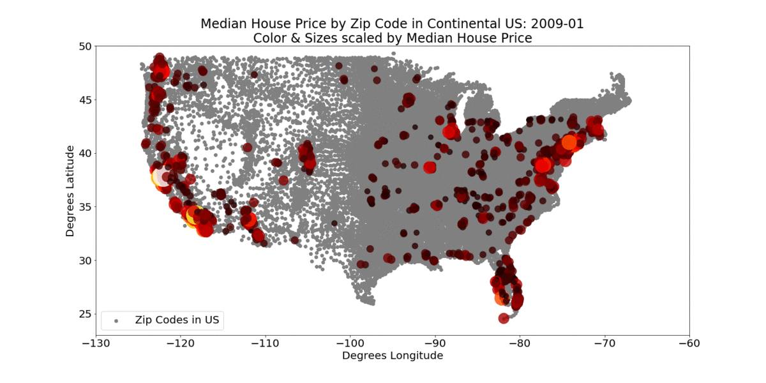
While cleaning our data, we decided to select 10 target cities to analyze housing prices to answer our questions
Seattle
Chicago
Cleveland
New York
Philly
LA
Atlanta
Phoenix
Dallas
Miami
Housing Price Snap Shot every 6 months over the last 10 years

Slide 5
Demographic 1

Slide 6
Demographic 2

Slide 7
Weather 1

Slide 8
Weather 2

Slide 9
Average house price was converted to mortgage payments using a function to compare buying versus renting

Slide 10
Mortgage payments versus rental payments show if you should buy or rent in a given city

Slide 11
Rentals 2

Slide 12
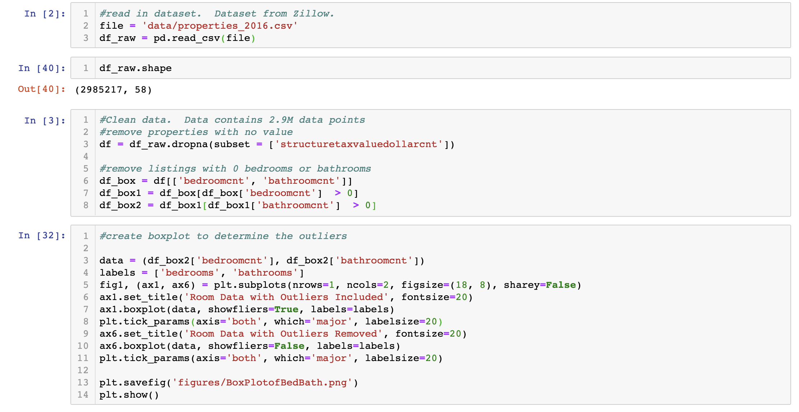
Layout data was analyzed for 2.9 million housing properties in 2016 for LA, Ventura, and Orange County
2.98M data points, 58 columns

Slide 13
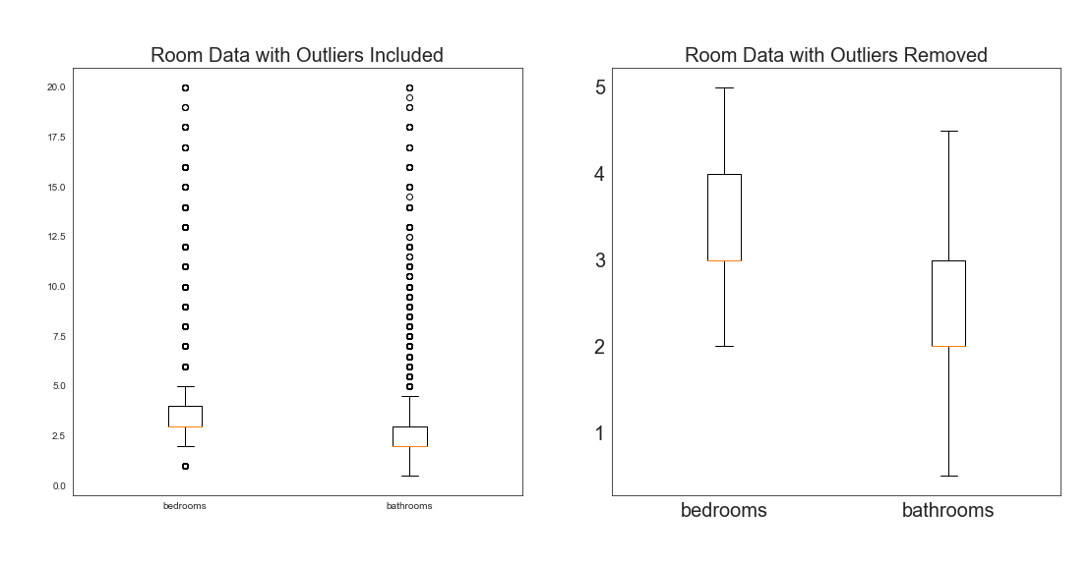
Layout data was analyzed for 2.9 million housing properties in 2016 for LA, Ventura, and Orange County
Data cleanup showed many outliers that needed to be filtered

Slide 14
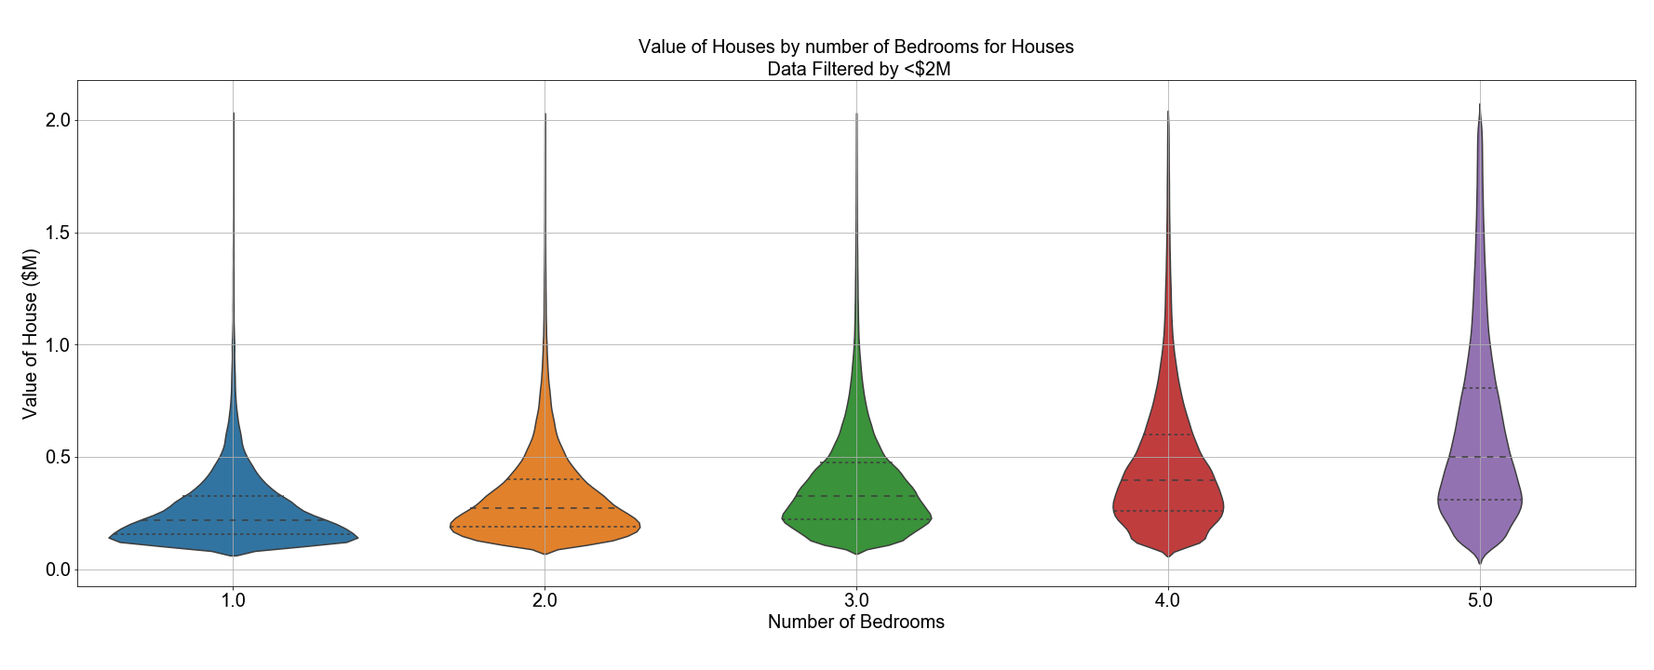
In general, as the number of bedrooms increased, the average house value increased
Avg:
$271,563
$332,724
$388,880
$475,325
$613,218
Increase:
+$61,161
+$56,156
+$86,445
+$137,893

Slide 15
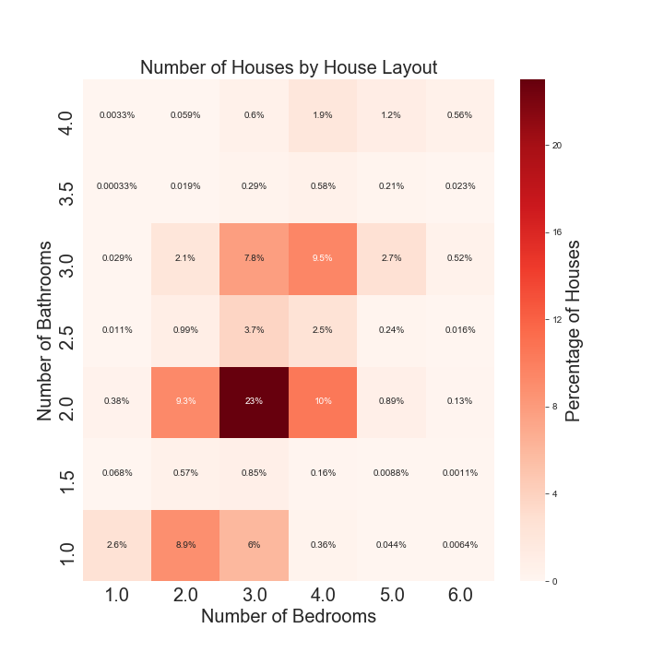
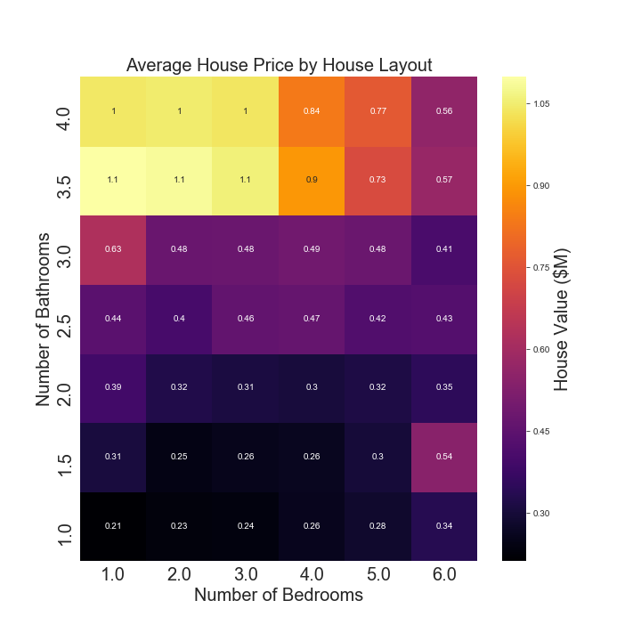
Heatmaps were used to show the average price per layout, as well as most common layouts

Slide 16
Heatmaps were used to show the average price per layout, as well as most common layouts

Slide 17
Heatmaps were used to show the average price per layout, as well as most common layouts
3BR, 2BA: $310,000

Slide 18
Summary

Slide 19
Post-Mortem

